Slide 1
9 Linear operators on finite-dimensional vector spaces

Slide 2
Introduction
In this topic, we will
Review some of the properties seen in the last chapter
Now focus on linear operators on finite-dimensional vector spaces
Describe the properties we will examine in this chapter

Slide 3
Linear operators on R^{n}
Suppose that A:R^{n} → R^{n} is a linear operator
That is, A ∈ ℒ (R^{n})
As we have seen:
All such linear operators can be represented by square matrices
All square matrices represent linear operators

Slide 4
Properties of linear maps
Given a linear map, we have already seen that we can describe
The range
The null space
From these, we may determine whether a linear map is
Onto
One-to-one
We deduced that
If the dimension of the range equals the dimension of the co-domain, the map is onto
If the dimension of the null space is zero, the map is one-to-one

Slide 5
Properties of linear maps
For example, if A:R^{n} → R^{m} and
If n > m,
There are at least n – m > 0 free variables
The null space has dimension at least n – m > 0
The linear map is not one-to-one
If n < m,
The maximum number of basis vectors of the range is n < m,
The dimension of the range is less than m
The linear map is not onto

Slide 6
Properties of linear operators
Thus, only a linear operator A:R^{n} → R^{n} on finite-dimensional vector spaces may possibly be both one-to-one and onto
If rank(A) = n, then it is one-to-one and onto
If rank(A) < n, then it is neither one-to-one nor onto
These are an important classification of linear maps
Given a square matrix,
we will find three additional properties of the matrix:
The determinant
The trace
The inverse if it exists

Slide 7
Summary
Following this topic, you now
Understand what will be covered in the next chapter
Know we are looking at properties of square matrices
Are aware that these properties will allow us to describe the behavior of these matrices

Slide 8
References
[1] https://en.wikipedia.org/wiki/Linear_map

Slide 9
Acknowledgments
None so far.

Slide 10
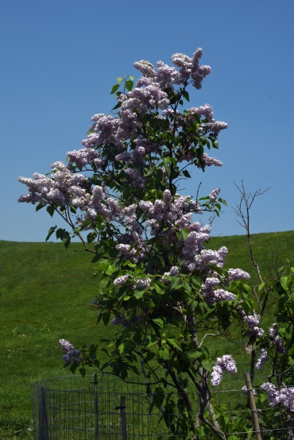
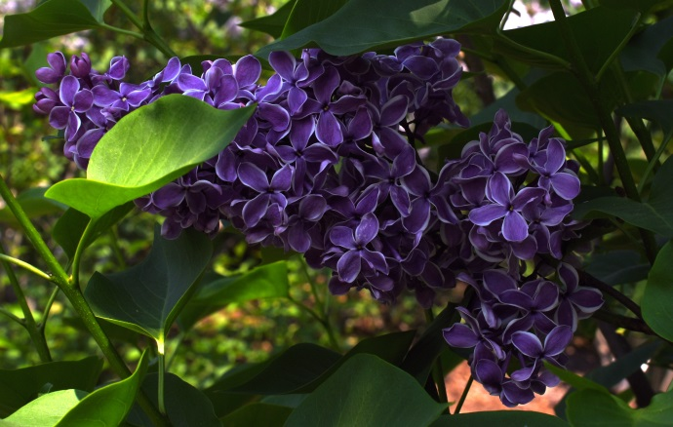
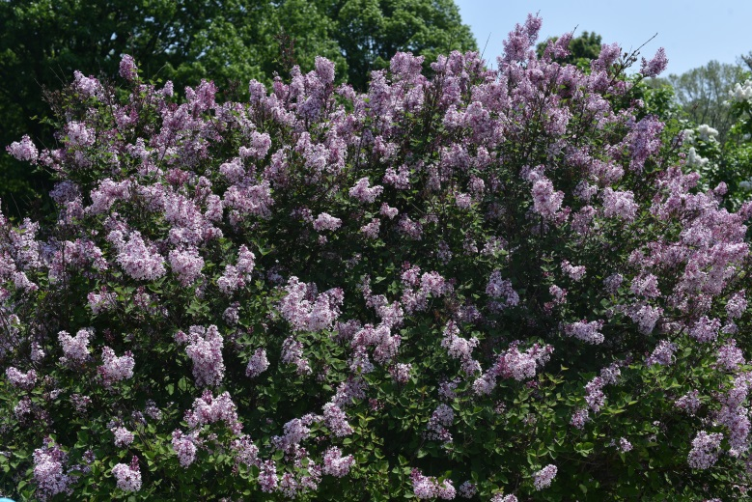
Colophon
These slides were prepared using the Cambria typeface. Mathematical equations use Times New Roman, and source code is presented using Consolas. Mathematical equations are prepared in MathType by Design Science, Inc.
Examples may be formulated and checked using Maple by Maplesoft, Inc.
The photographs of flowers and a monarch butter appearing on the title slide and accenting the top of each other slide were taken at the Royal Botanical Gardens in October of 2017 by Douglas Wilhelm Harder. Please see
https://www.rbg.ca/
for more information.

Slide 11
Disclaimer
These slides are provided for the ne 112 Linear algebra for nanotechnology engineering course taught at the University of Waterloo. The material in it reflects the authors’ best judgment in light of the information available to them at the time of preparation. Any reliance on these course slides by any party for any other purpose are the responsibility of such parties. The authors accept no responsibility for damages, if any, suffered by any party as a result of decisions made or actions based on these course slides for any other purpose than that for which it was intended.

